Slide 1


Graduate Qualifying Project & Professional Journey
Vandana Anand
October 27th, 2021

Slide 2
Agenda
(1) Introduction
(2) GQP Project Overview
(3) Key Takeaways & Learnings from GQP
(4) Verizon Position, Work Responsibilities, How GQP Helped
(5) Tips and Skills for Data Science Interviews and Jobs
(6) Questions & Answers
Notes:
(1) Briefly present your GQP project.
(2) Share the valuable lesson, experience, and fun facts during your GQP journey.
(3) Describe your current work/position and how the GQP experience help you excel in your work/position.
(4) Provide key tips and skills for championing Data Science job interviews and your current position responsibility.
(5) Questions & Answers

Slide 3

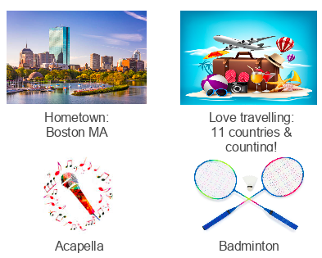
Vandana Anand
Bachelor’s in Computer Science ‘19
------------------------------
Master’s in Data Science ‘20
Digital Marketing Catalyst VLDP (Data Science Analyst) on Business Enablement team
Notes:
Completed Bachelor’s in December 2019 and Master’s in December 2020
VLDP = Verizon Leadership Development Program

Slide 4
GQP Project

Slide 5

Entity Linking WPI-Basis Technology Project
Sept 2020-Dec 2020
Team members: Kratika Agrawal, Vandana Anand, Xinlu He, Min Huang, Soumya Joshi, Jing Yu Basis Technology Mentors: Gil Irizarry, Kfir Bar, Lital Ravid, Karin Lin, Zachary Yocum
WPI Mentors: Prof. Chun-Kit Ngan, Prof. Fatemeh Emdad

Slide 6




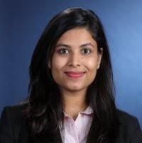

Project Team Introduction
Sponsors & Mentors
Gil Irizarry Kfir Bar
Vice President - Engineering Chief Scientist
gil@basistech.com kfir@basistech.com
Latent Relations
End2End
DeepType
Soumya Joshi sjoshi2@wpi.edu | Min Huang mhuang3@wpi.edu | Vandana Anand vanand@wpi.edu | Xinlu He xhe4@wpi.edu | Kratika Agrawal kagrawal@wpi.edu | Jing Yu jyu5@wpi.edu

Slide 7

Project Goal
Goal: Improve BT’s current entity linking tool Rosette by applying a novel model to increase entity linking performance.
Notes:
Rosette overall is an adaptable platform for text analytics & discovery. It offers various
capabilities to efficiently analyze documents in more than 30 languages. Tasks supported by
Rosette include chat translation, document categorization, parts of speech tagging, entity
extraction, entity linking (EL), and more.

Slide 8
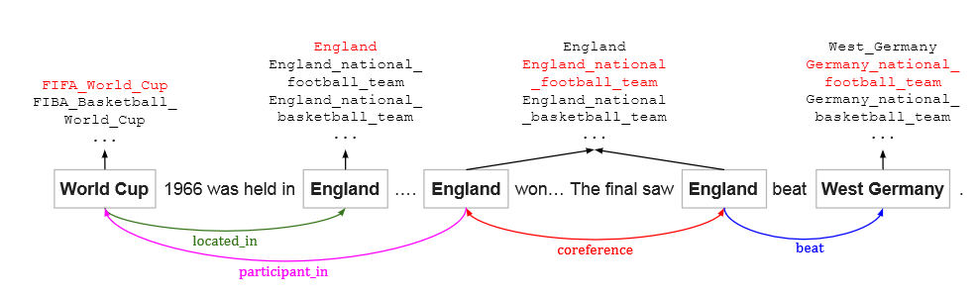
Our Entity Linking System
Named Entity Linking / Entity disambiguation method explained above includes the co-reference which is a relation between two or more mentions in a text when they refer to the same entity
Notes:
The Named-Entity
Linking task aims to extract all named entities (ie. person, organization, location, etc) from a text
document, called Entity Extraction/Entity Detection/Named-Entity Recognition, and link the
identified mentions to an entity record in the WikiData database.
EL itself is a task that can be subdivided into Entity Extraction (EE) and Entity Disambiguation
(ED). Thus, to link any entity to the corresponding record in the knowledge base, it should be
ensured that the true entity in the knowledge base is chosen among all candidate entities in the
knowledge base with the same name by following a procedure that takes several factors of the
text into consideration.

Slide 9
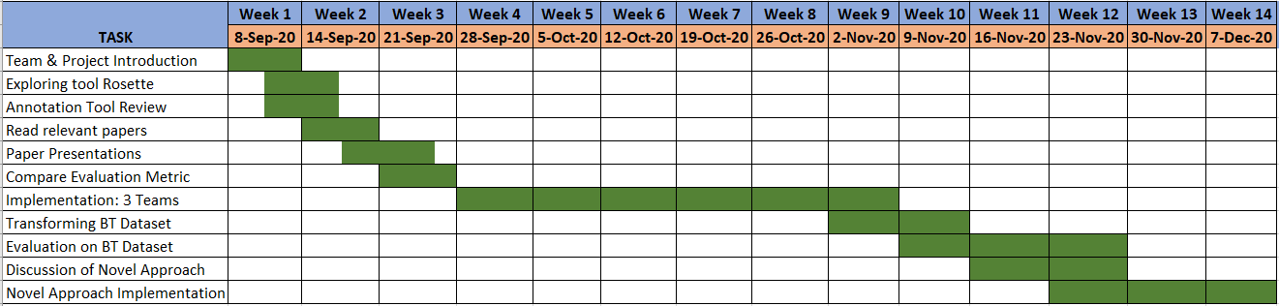
Project Timeline
Notes:
For our solution, we decided to implement 3 different models and split up into teams of 2 in order to come up with the best performing model for BT’s dataset. We did research on the papers for each model, outlining the general sense of what each model does and the technicalities of implementing each one. We then presented the findings from our research to our sponsor and finalized the approach. After that point, we worked parallelly to develop the 3 models: Latent Relations, End to End, and DeepType/Robust Disambiguation. We outlined our implementation approach, created a design, transformed the BT dataset as well as other datasets such as AIDA, ran the models, and gathered the results to present the final outcome to BT.

Slide 10

Latent Relations Model

Slide 11
Research Problems Addressed
Tackled candidate selection problem which is to choose best entity from a list of candidates by
local and global modeling
Innovatively including latent relations between mentions into the global model
Eliminated the need for extensive feature engineering by using representation learning to learn relation embeddings

Slide 12
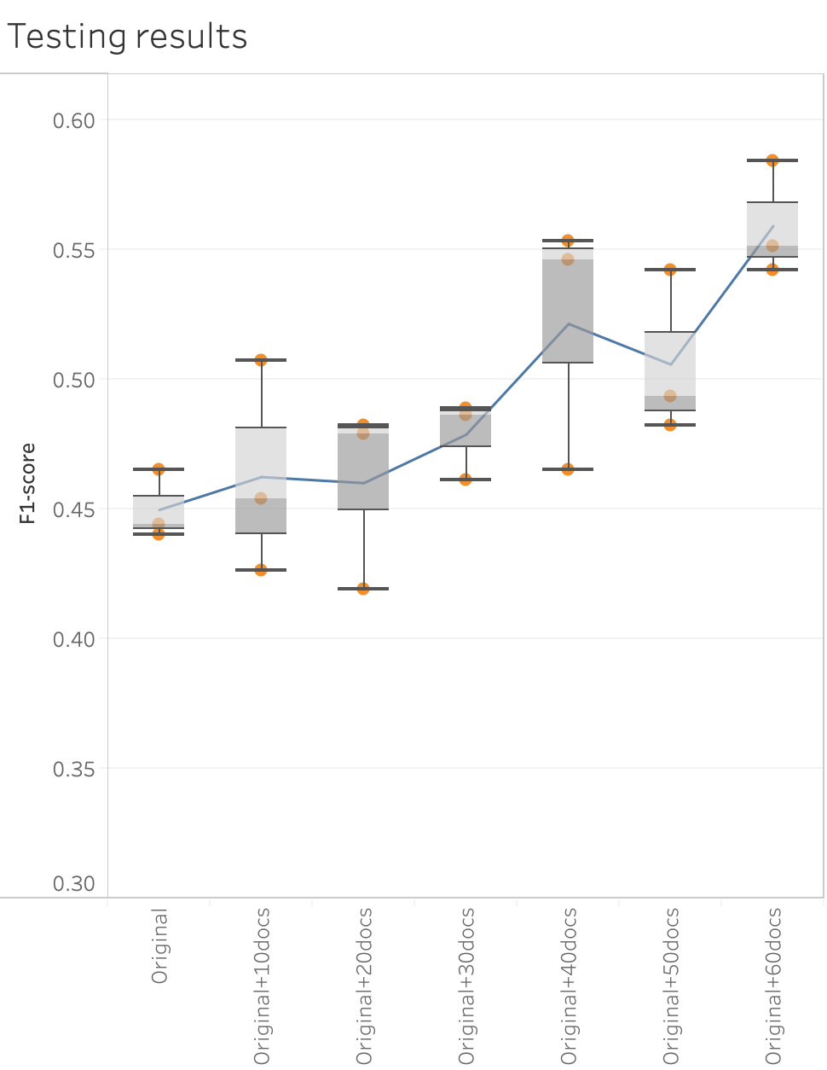
Results
Successfully applied BT dataset into the latent relations model
Better F1 score with larger BT dataset

Slide 13
Conclusion & Future Scope
Conclusion:
Successfully applied BT dataset into latent relations model
Better F1 score with larger BT dataset
Future Scope:
More training rounds are needed to reduce the randomness
Larger BT dataset is required
Generate candidates based on latest version wikipedia KB
Might bring higher F1 score

Slide 14
Project References
Improving Entity Linking by Modeling Latent Relations between Mentions: https://arxiv.org/pdf/1804.10637.pdf
Latent Relations Model Github: https://github.com/lephong/mulrel-nel
Deep Joint Entity Disambiguation with Local Neural Attention: https://arxiv.org/pdf/1704.04920.pdf
Deep Joint Model Github: https://github.com/dalab/deep-ed

Slide 15
End2End Model

Slide 16

Advantage of the End2End Model
Other Research
End2End Model
Original Text
Worcester Polytechnic Institute is a private research university in MA.
Entity Extractor
Mention Detection
End2End Model
Worcester
Worcester Polytechnic Institute
MA
Entity Disambiguation Model
Entity Disambig-
uation
Worcester
Worcester_Polytechnic_Institute
Worcester_Polytechnic_Institute
Massachusetts
Massachusetts
Notes:
Errors caused by MD/NER will propagate to ED without possibility of recovery
This research: Loss value is high, change the parameter in the detection process and disambiguation process,
emphasize the importance of the mutual dependency between MD and ED
MD influences ED: numerous and more informative linkable spans found by MD obviously
ED influences MD: finding the true entities appearing in a specific context encourages better mention boundaries,
especially for multi-word mentions
offer more contextual cues for ED
For Basis Technology, rosette, just a try since we already have the extractor

Slide 17
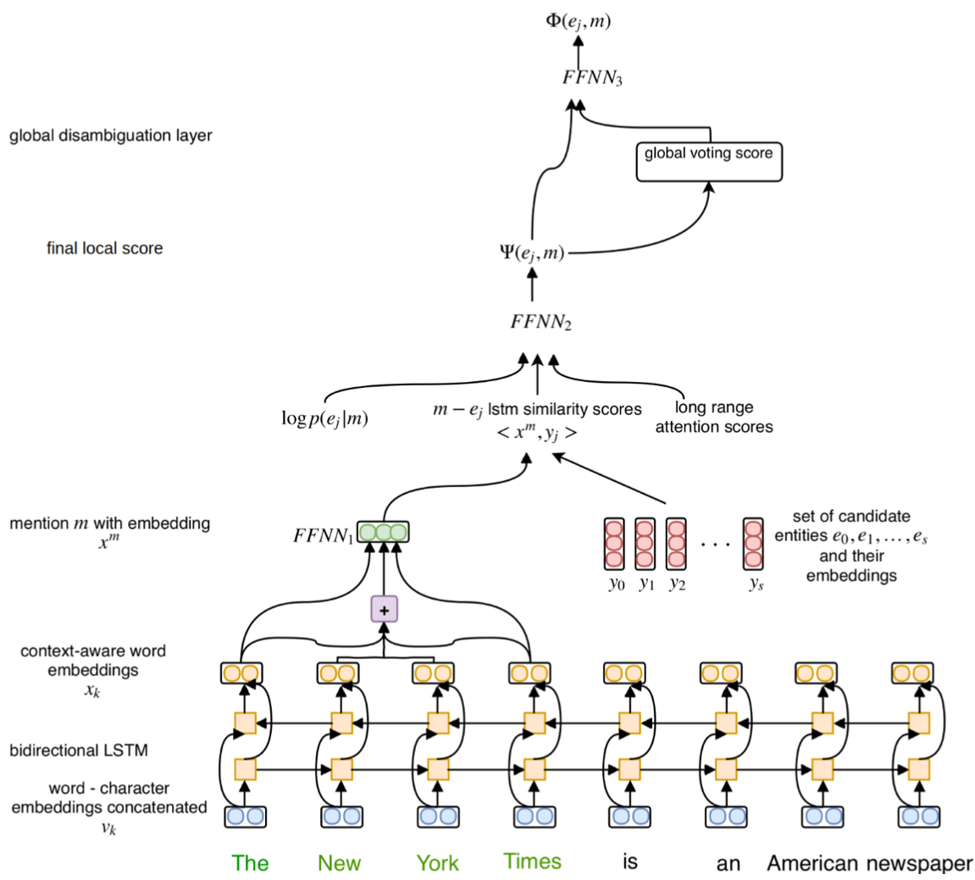
Overview of the End2End Paper
Output: Final Score
(For mention-entity pair: Is this
entity candidate suitable here)
local score
try different spans--mention
local score
Input: the Whole Text
Notes:
Don’t have to read all the words in it and understand all the function,
output:
each mention in the original text, will have several entity candidates and the candidate with the highest score ei
➔ local score: information from analysis focus on mention and relationship between mention and entity candidates
➔ global score: analysis focus on the relationship among entity candidates in KB

Slide 18
End2End Paper - Candidate Selection
Mention--Entity Candidate pair:
e.g:
Discovery Discovery Channel--basic cable and satellite television channel
Star Trek: Discovery--American television series
Discovery--space shuttle orbiter
Discovery--2001 album by Daft Punk
How to get candidate-- Prior Possibility
The ratio of the times the pair appears to the times the mention appears in KB
KB: a lot of text sample--Wikipedia2014
30 candidates
If already know the mention (eg: The New York )
lose advantage: loose part of the context information
don’t have to analyze all the spans

Slide 19
End2End Paper - Other Skills
Word2Vec
transfer the word into vector
the cosine similarity indicates the level of semantic similarity between the words
pre-trained
Bi-derection LSTM
both inside a word and the mention between word
lexical information in Character Embeddings
context- aware

Slide 20
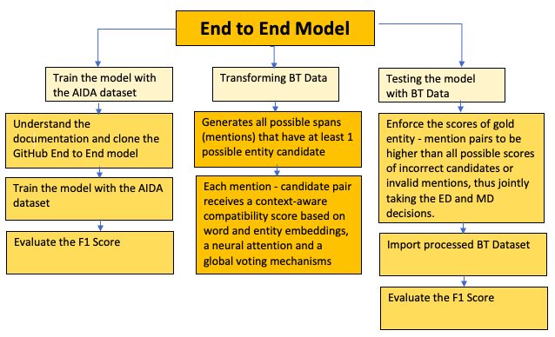
Paper Implementation Workflow
✓
✓
Notes:
Transforming BT data: Using word2vec to transform all the words to a number so that we can use the model for testing

Slide 21
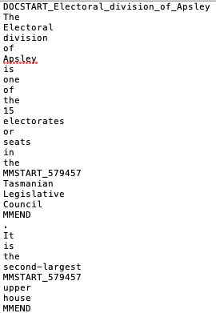
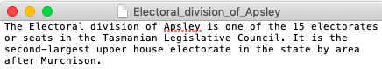
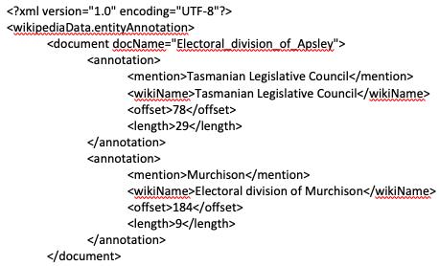
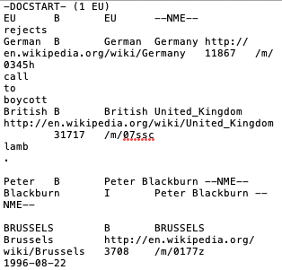
Preparing the dataset
Datasets
aida_train
aida_test
aida_dev
ace2004
aquaint
clueweb
msnbc
wikipedia
Format
Preprocessing Output
Text
Wikipedia
XML
AIDA

Slide 22
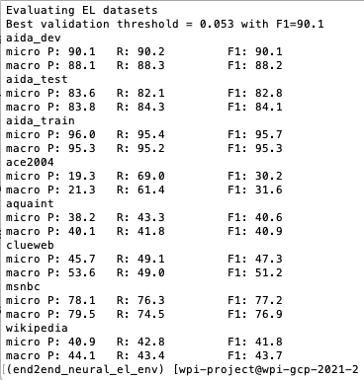
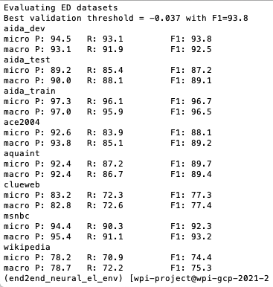
Training the Model
Entity Linking Training
Entity Disambiguation Training
Model
Performance
Notes:
ED performed a lot better than EL especially for the Wikipedia dataset
The training model on different datasets for both EL and ED performed a bit worse overall than the latent model whose wiki training was the lowest performing dataset at 77%. However here, the Wiki dataset is at 74-75% which is lower.
Micro/Macro - For EL, these metrics are computed both in the strong matching and weak matching settings. Micro requires exactly predicting the gold mention boundaries and their entity annotations, whereas Macro gives a perfect score to spans that just overlap with the gold mentions and are linked to the correct gold entities.

Slide 23
Testing the Model w/ AIDA and other datasets
Entity Disambiguation | Train Score | Test Score | Test Precision | Test Recall
Best Scores | 92.2% | 85.7% | 88.5% | 83%
Entity Linking | Train Score | Test Score | Test Precision | Test Recall
Best Scores | 62.9% | 56.8% | 57.5% | 56.1%
Using all Spans Best Score | 89.1% | 80.1% | 83.5% | 76.9%
Notes:
The end2end model could be worse than latent if our input is the golden mention-candidate pair
ED -> We may have gotten a lower score because we don’t have much of an advantage than the model in the research paper. We are using the whole text instead of an extractor
While processing the BT dataset, we trained and tested the AIDA data to see what we could expect. We used the base model for EL and ED training/testing on the AIDA dataset which ran overnight and obtained these scores. ED performed a lot better than EL overall. The entity linking scores are very similar to the final latent relations model accuracy, around 55%. However, this score is significantly improved when taking into account all the spans of the text document. We expect to see similar or lower scores for the BT dataset because it will be smaller with around 3000 mentions whereas the AIDA dataset has more than 502K mentions.

Slide 24
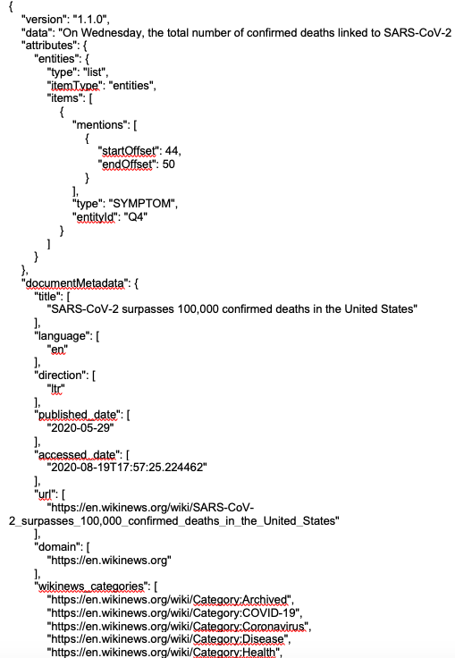
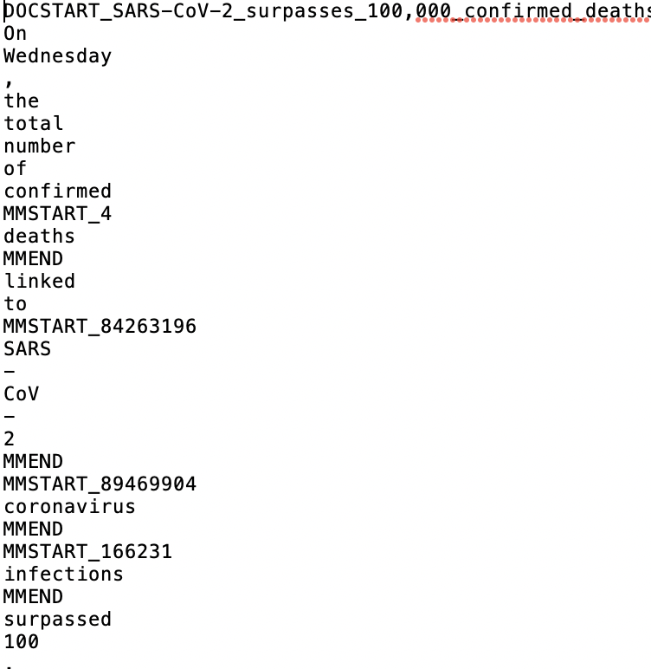
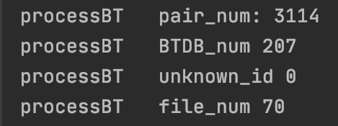
Preparing the BT dataset
JSON
Doc start: DOCSTART_fileName
row: word or punc
mention: start with “MMSTART_Wikiid”
end with “MMEND”
between paragraph: *NL*
Notes:
In order to test the BT dataset, we first had to transform and preprocess it so that it would be compatible with the End2End model. A challenge here is that the BT dataset was in a different format than the other datasets that we saw, in a json format. We worked to rewrite the preprocessing code so that we could get a similar processed dataset output like the rest of the training datasets.

Slide 25
Future Scope
Testing the End2End Model with the BT dataset (cannot plug in directly )
Rearranging the implementation code to be compatible with BT’s data structure
Evaluating the accuracy of the model on BT’s dataset
Running the model on BT’s server and integrating with existing processes to improve entity procedures
Notes:
Challenges in testing the BT dataset (Xinlu):
academic purpose, complicated:
3 models: base model, with global score, with golden data
different platform: Gerbil
data: from 5 or 6 different resources
dependence between files, data or python, is complicated and difficult to figure out

Slide 26
Project Conclusion
End2End: if only the word disambiguation process, the result cannot take much of an advantage of this model.
End2End gave reasonable accuracy on the AIDA testing set because the number of mentions is so big. Since BT’s data is lower we expect this number to be lower as well
We learned:
Entity linking and entity disambiguation processes
Researching and understanding how the End2End model works
Preprocessing various datasets and transforming BT’s data to be compatible with the model
Notes:
ED -> We may have gotten a lower score because we don’t have much of an advantage than the model in the research paper. We are using the whole text instead of an extractor

Slide 27
Project References
Research Paper: https://arxiv.org/pdf/1808.07699.pdf
End2End Github: https://github.com/dalab/end2end_neural_el
https://github.com/lephong/mulrel-nel (Entity Linking)
https://github.com/basis-technology-corp/annotated-data-model
https://github.com/basis-technology-corp/wpi-gqp-2020 (BT data)

Slide 28
DeepType Model: Multilingual Entity Linking by Neural Type System Evolution

Slide 29
Deep Type: Implementation
Progress:
Downloaded Wikidata & Wikipedia latest dumps
Building Type System
Followed varied approaches in building type system
Limitations:
Large files, need even larger space to run the whole process
Incompatible packages and data dump
Needed more time for building Type System through WikiAPI
Lesson Learnt:
Assumes strong coherence among entities
Entities can be easily disambiguated using Type System graph
More accuracy if learnability is more for Type System knowledge base
Notes:
Wikidata dumps > 150GB
Wikipedia english language latest dumps ~ 76GB

Slide 30
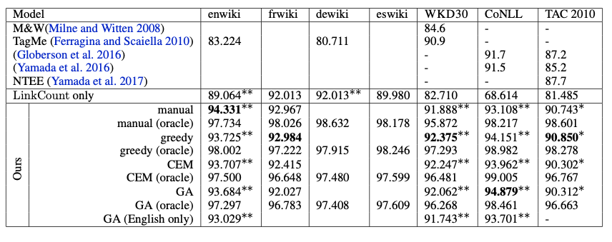
Deep Type: Reported Results in the paper
Significant improvements over prior work denoted by ∗ for p < 0.05, and ∗∗ for p < 0.01.
Notes:
SOTA

Slide 31
Project References
DeepType Multilingual Entity Linking by Neural Type System Evolution: https://arxiv.org/pdf/1802.01021.pdf
DeepType Source Code: https://github.com/openai/deeptype

Slide 32
Novel Approach
with
Robust Disambiguation
BASIS TECHNOLOGY | Worcester Polytechnic Institute

Slide 33
Robust Disambiguation Approach
Prior Probability Score
Robust Disambiguation
Context-based Similarity Score
Generate Graph
Coherence Among Entities

Slide 34
Novel Disambiguation Approach
Robust Disambiguation
Vectors Embeddings
Novel Disambiguation
Convolution Neural Network

Slide 35
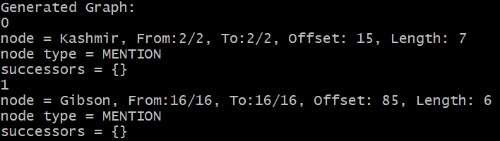
Novel Model: Graph Generation
Done:
Use Robust Disambiguation technique code to produce graph
https://github.com/codepie/aida
Installed PostgreSQL 9.6.0
Downloaded Yago dumps
Imported Yago dumps in PostgreSQL
Extract Mention Nodes, Entity Nodes and edge information from the generated graph
They performed Kashmir, written by Page and Plant. Page played unusual chords on his Gibson.

Slide 36
Future Scope
Establish connection between PostgreSQL and AIDA repository
Develop weighted graph
Translate weighted Graph => weighted Adjacency Matrices
Generate Graph: AIDA dataset and Basis Technology dataset
Get Embeddings: AIDA dataset and Basis Technology dataset
Perform Training of CNN model
Evaluate performance on Basis Technology dataset

Slide 37
Project References
Robust Disambiguation of Named Entities in Text: https://www.aclweb.org/anthology/D11-1072.pdf
AIDA Online Demo: https://aida.dor.ai/overview
AIDA Source Code: https://github.com/codepie/aida
Wikipedia2Vec: https://wikipedia2vec.github.io/wikipedia2vec/

Slide 38
Overall Learning

Slide 39
Conduct research and apply models in a hands - on approach
Learnings
Exposure to various deep learning and natural language processing techniques
Preprocessing a dataset is very important and can be an involved step
Importance of formatting train/test datasets as it can alter a model’s performance
Understanding and overcoming technical challenges

Slide 40
Thank You
Sponsors & Mentors:
Gil Irizarry
Vice President -Engineering
gil@basistech.com
Kfir Bar
Chief Scientist
kfir@basistech.com
Instructors:
Prof. Chun-Kit (Ben) Ngan
Professor
cngan@wpi.edu
Prof. Fatemeh Emdad Professor femdad@wpi.edu
Prof. Elke A. Rundensteiner
Director of Data Science
rundenst@wpi.edu

Slide 41
Verizon Role: Digital Marketing Catalyst

Slide 42
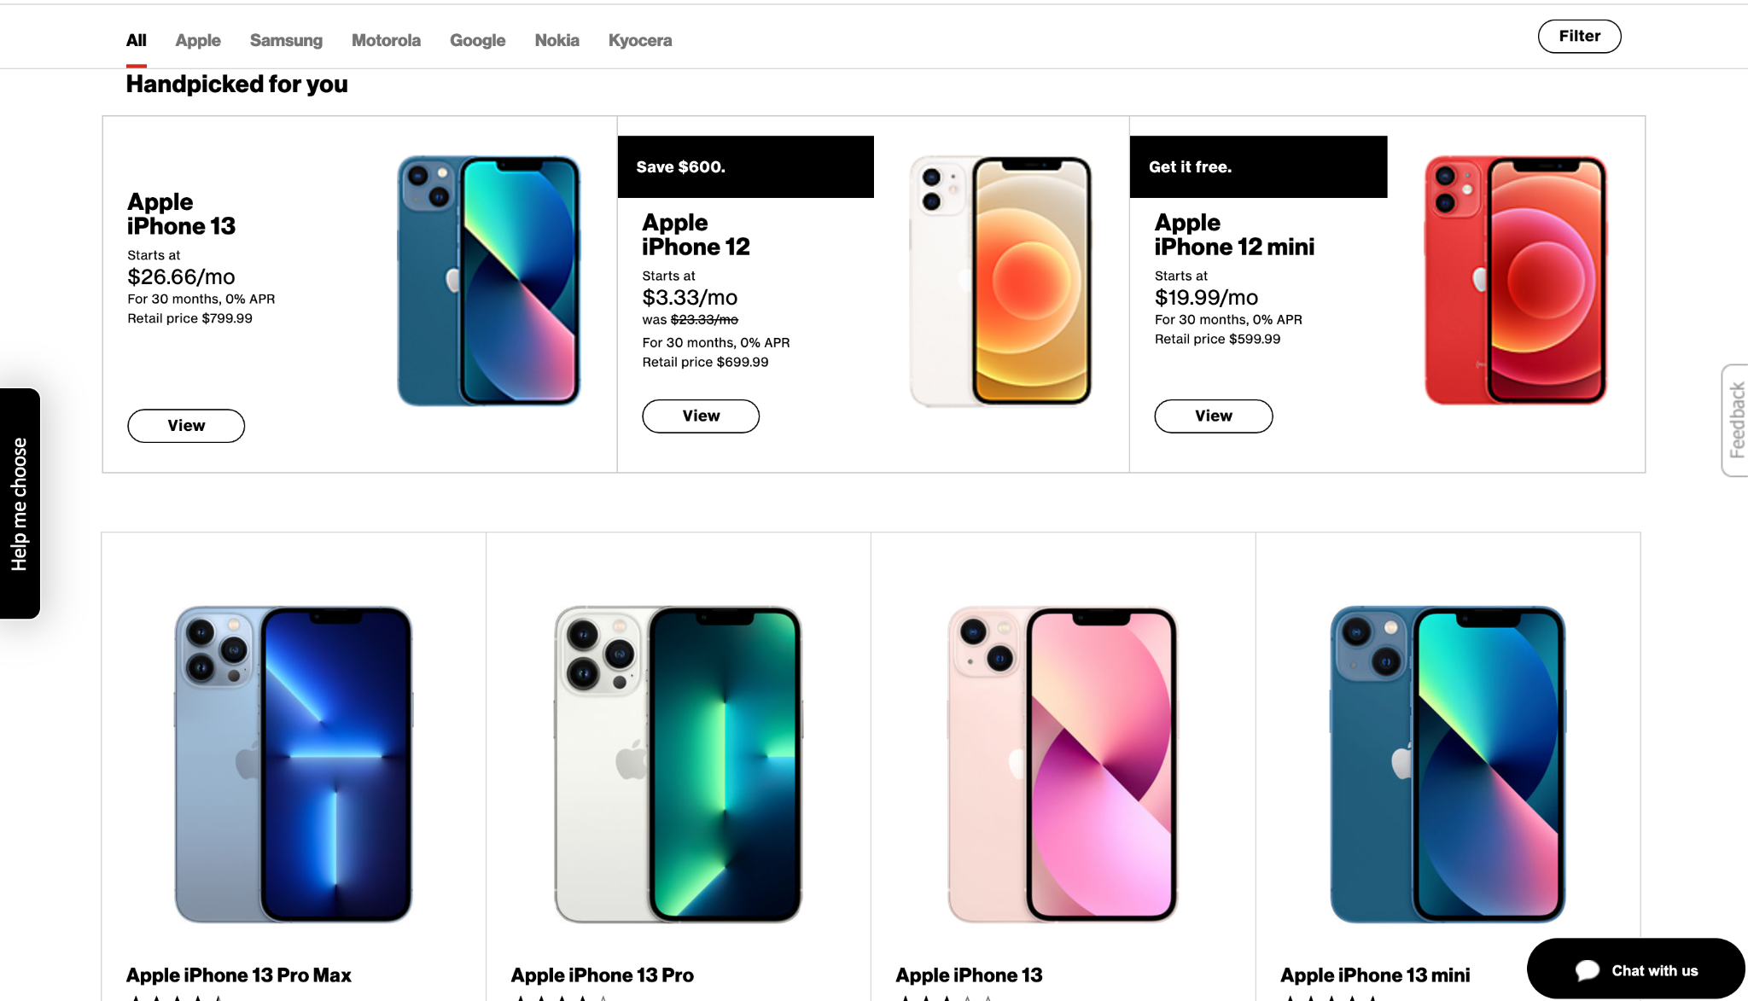
Verizon Position
Verizon Leadership
Development Program (VLDP)
Designed to drive success of Verizon’s future leaders.
Provides college graduates a 3-4 year immersive experience as the build leadership skills
Customized job rotations, leadership development curriculum, networking activities, hands-on learning, and opportunity to present to senior leadership
Marketing Catalyst in Digital Sales
Digital Sales = driving marketing, sales and growth on Verizon.com using Artificial Intelligence (AI) and Machine Learning (ML)
Notes:
Areas supported in Digital sales: devices (smartphone, tablets, PDP recommendations and accessories recommendations)

Slide 43
Marketing Catalyst in Digital Sales
What do we do?
Innovate and initiate business problems to drive AI driven solutions, derive actionable insights, and push forward marketing and sales.
Understand the business problem
Translate technical tasks that need to be carried out
Connect with the right team members
Apply problem solving techniques
Follow through with the team to deliver results
Teams we interact with:
Business
Marketing
Data Engineering
Global Technology Services (GTS) - Frontend/Backend engineers & Architects
AI Center (Data Scientists)

Slide 44
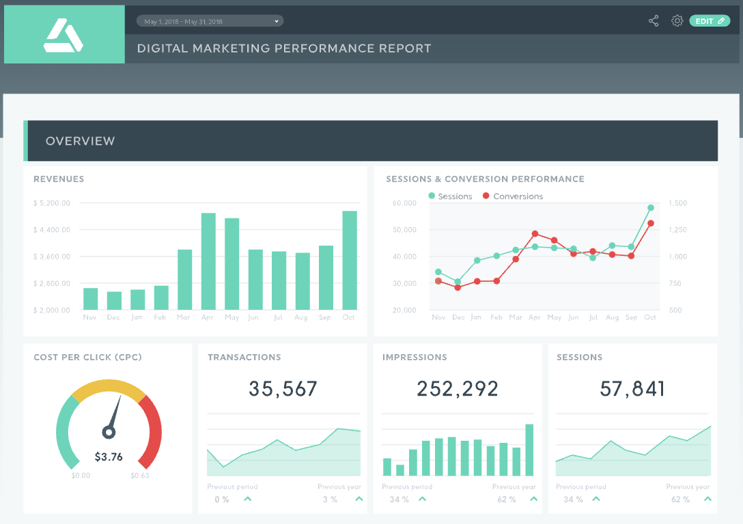




Projects
Consolidate Reporting
Establish a one stop shop to evaluate models and personalization services on the digital platform
Analysis
Use reporting tools to assess model performance as well as user behavior, trends, and interaction. Identify areas of opportunities to implement AI/ML. Derive business value for model/experience implementations
Confluence Page
Document team’s projects and share with the business to get up to speed on evaluating the enabled services
Notes:
Easier way to report recommendation effectives in the digital flow/experience. This include monitoring Key performance indicators such as click rate, conversion rate, attach rate, call in rate, order details as well as post order metrics such as return rate.
Continuously thinking of new, innovative ways to improve the digital experience for customers.

Slide 45
How GQP Helped
Hands on project based experience and effective teamwork skills
Learning to run effective meetings
Presenting to sponsors that prepared me for executive leadership level presentations
Translating complex technical concepts into understandable bullet points
Exposure to different type of models that I can apply at work and suggest innovative approaches to business problems

Slide 46
Tips & Skills

Slide 47
Interviews & Workplace Tips/Skills
Behavioral
Prepare by thinking of 2-3 teamwork experiences
Being spontaneous takes practice!
Soft skills are very important in the real world
It’s okay to take risks, we learn valuable lessons when we pick up ourselves
Take business classes to understand the concepts
Technical
Do your research about interesting and innovative technologies applied in the field
Talk about your ideas and how you might integrate into the current process and develop it
Leetcode for programming,
SQL and Python are significant
Having technical knowledge is key to communicating effectively with various teams

Slide 48
Q&A
Notes:
Questions I received:
1. Are there any other machine learning techniques besides recommendation based models that are implemented at Verizon?
2. How are the models deployed into production at Verizon? What kind of tech stack do you use?

